Slide 1
Enhancing CNN Interpretability
Using Multi-Layer Feature Extraction with Decision Trees
By: Kanishk Sivanandam and Chetan Maviti

Slide 2
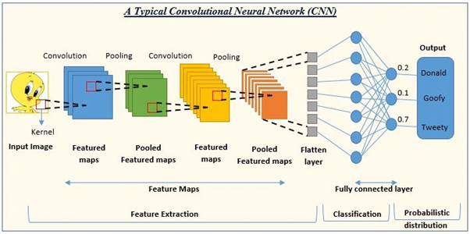
Project Objective
CNNs are widely used in image classification, but their decision-making process is hard to interpret (black boxes)
Medical AI applications require interpretable results to ensure patient safety
Notes:
https://www.cdc.gov/stroke/data-research/facts-stats/index.html

Slide 3
Relevant Work/Info
Neural-Backed Decision Trees (NBDT) - ICLR 2021
Replaces CNN’s fully connected layer with a hierarchical decision tree
Limitation: Uses only final-layer CNN features, disregarding lower/mid-level patterns
PCA for Dimensionality Reduction in CNNs
PCA is utilized for feature ‘compression’ while still preserving as much variance within the dataset as possible
PCA reduces the number of features, ultimately leading to faster training time and potentially less overfitting.
How is PCA relevant to our project?
CNN features are extremely high-dimensional. PCA helps extract just the most relevant features through eigenvectors.
Leads to faster, more efficient decision tree creation

Slide 4
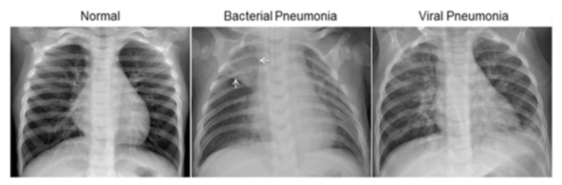
Dataset Overview
Public Dataset containing x-ray images for pneumonia classification
Dataset Size:
2186 instances
1562 Train, 624 Test (~70/30 Split)
Data is split into images for 2 classes:
Normal or Pneumonia
Dataset
Train
Normal
Pneumonia
Test
Normal
Pneumonia
Notes:
https://www.nhlbi.nih.gov/health/stroke/causes

Slide 5
Preprocessing
Image Resizing
Convert all images to 224 x 224 (required for ResNet50 input)
Color Conversion
Convert images from BGR (OpenCV) to RGB (PIL) for correct color representation
Normalization
Apply ImageNet mean and standard deviation for consistent feature scaling
Mean: [0.485, 0.456, 0.406]
Std: [0.229, 0.224,0.225]
Label Encoding: (0 = Normal, 1 = Pneumonia)
Dataset Loading (32 images per batch for efficiency and shuffle data for training)

Slide 6
Methods (CNN+DT with Conv2, Conv4, Final)
Feature Extraction from CNN
X-Ray images are forward passed through the ResNet50 CNN model (pretrained on ImageNet)
Feature maps from Conv2, Conv4, and FC layers are extracted (output intercepted)
Conv2 → Low layer (edges, corners, textures)
Conv4 → Mid layer (shapes, structures, regions)
FC (fully connected) → Deep layer (high level representations of xrays)
Extracted features are concatenated into a single high-dimensional feature vector
Decision Tree trained on high-dimensional feature vector and evaluated
Dimensionality Reduction using PCA
Decision Tree trained on PCA-transformed features and evaluated

Slide 7
Methods (CNN+DT Final)
Feature Extraction from CNN
X-Ray images are forward passed through the ResNet50 CNN model (pretrained on ImageNet)
Feature maps from FC layer is extracted (output intercepted)
FC (fully connected) → Deep layer (high level representations of xrays)
Extracted features are concatenated into a single high-dimensional feature vector
Decision Tree trained on high-dimensional feature vector and evaluated
Dimensionality Reduction using PCA
Decision Tree trained on PCA-transformed features and evaluated

Slide 8
Methods (Standalone CNN)
Train ResNet50 on Pneumonia dataset
Replace the final fully connected layer with a 1-neuron ouptut + Sigmoid Activation for binary classification
Loss Function: Binary Cross-Entropy
Batch Size: 32
Training Time: 5 Epochs
Evaluate CNN performance with accuracy, precision and recall to compare with CNN+DT method

Slide 9
Results
Model | Accuracy | Runtime | Precision | Recall
CNN Only (ResNet50) | 83.81% | ~2.5 hours | 0.8 | 0.98
CNN → Decision Tree (Conv2, Conv4, Final) | 79.65% | ~11:10 (extract) ~8:25 (tree) = 19:36 mins | 0.77 | 0.95
CNN → Decision Tree (Final Only) | 74.52% | ~10:32 (extract) ~0:02 (tree) = 10:35 mins | 0.74 | 0.93

Slide 10
Results with PCA
Model | Accuracy | Runtime | Precision | Recall
CNN → Decision Tree (Conv2, Conv4, Final) | 79.65% | ~11:10 (extract) ~8:25 (tree) = 19:36 mins | 0.77 | 0.95
PCA | 79.17% | ~11:10 (extract) ~1:43 (PCA+tree) = 12:54 mins | 0.79 | 0.92
CNN → Decision Tree (Final Only) | 74.52% | ~10:32 (extract) ~00:02 (tree) = 10:35 mins | 0.74 | 0.93
PCA | 73.56% | ~10:32 (extract) ~0:006 (PCA+tree) = 10:33 mins | 0.74 | 0.90

Slide 11
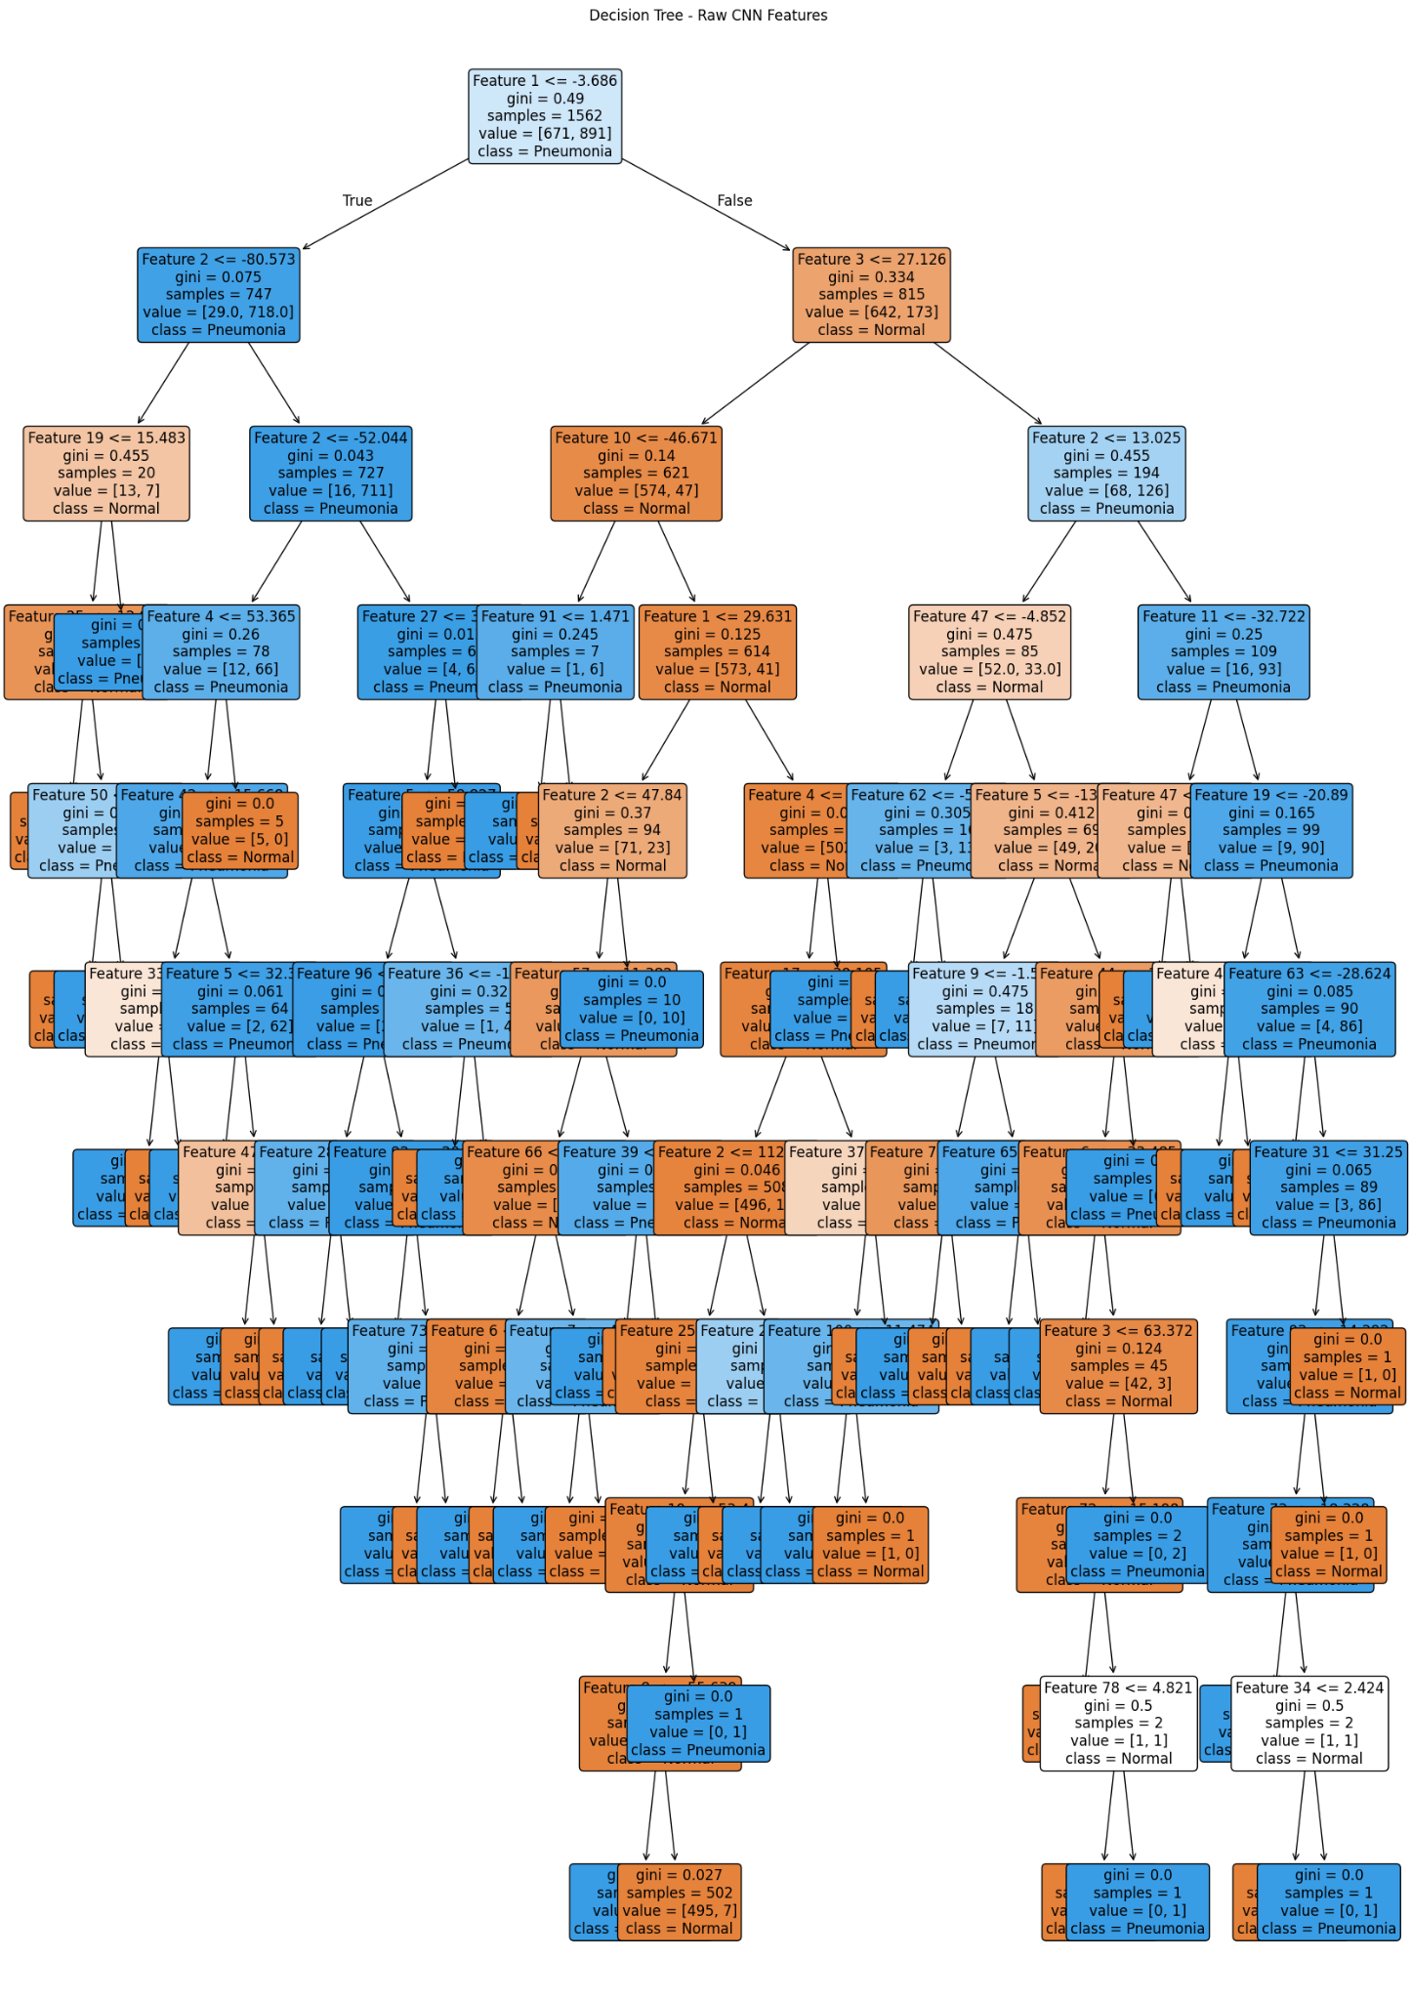
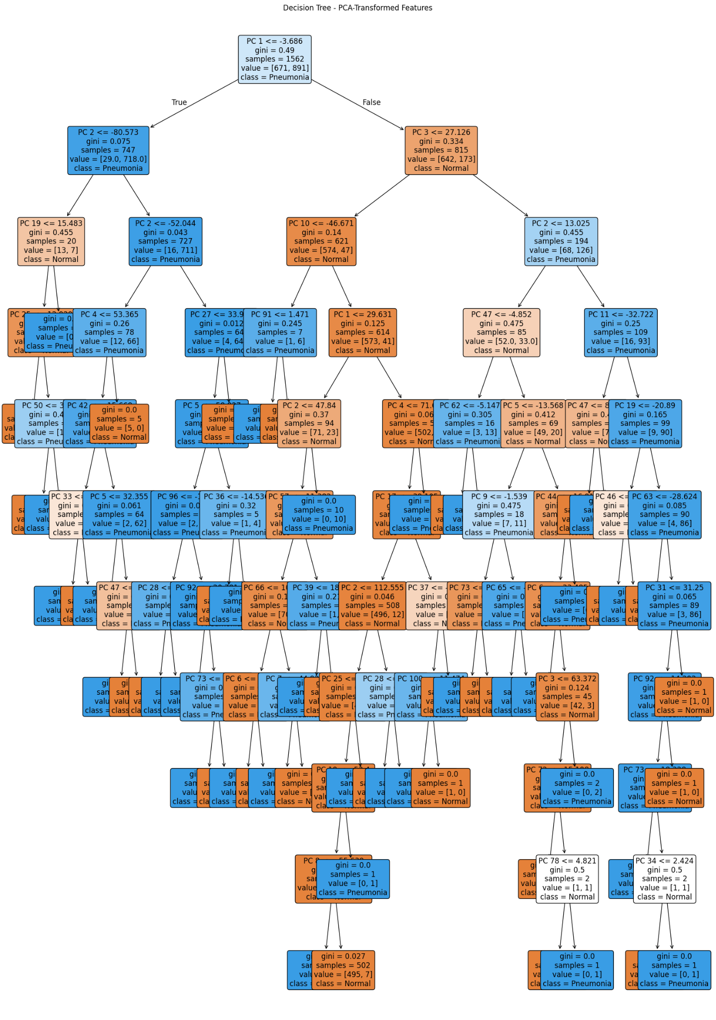
Interpretability (CNN+DT with Conv2, Conv4, Final)

Slide 12
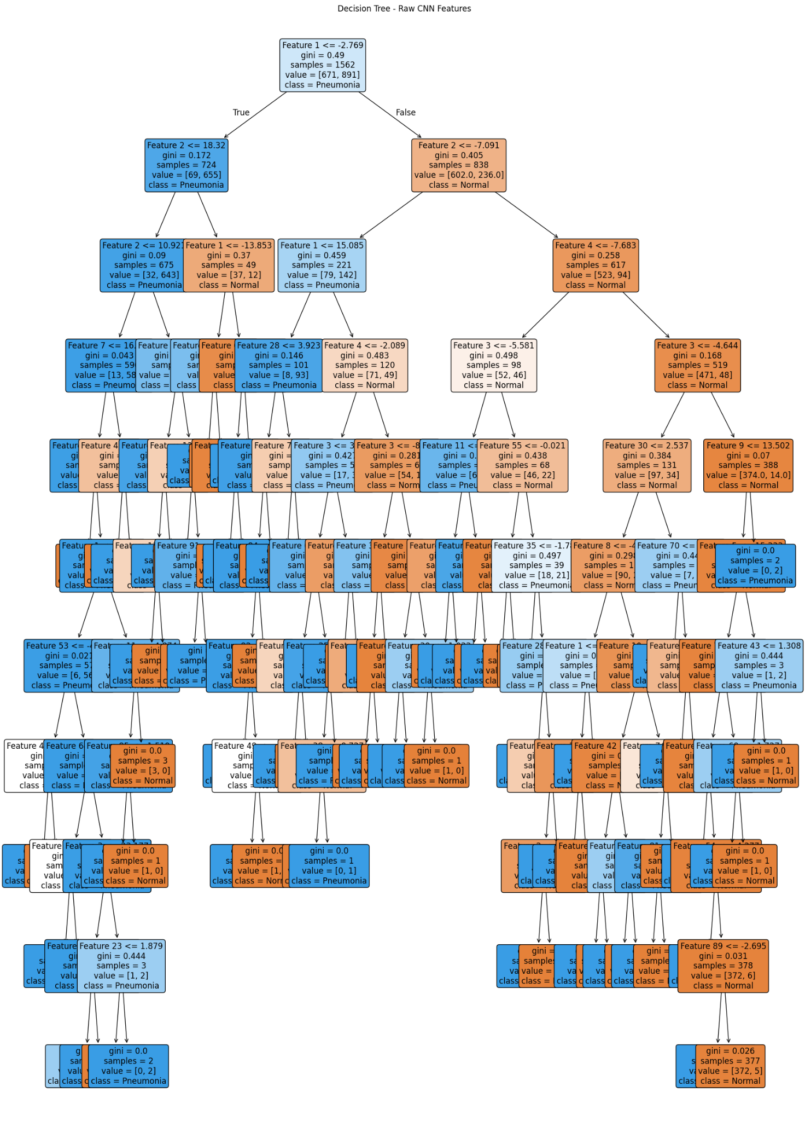
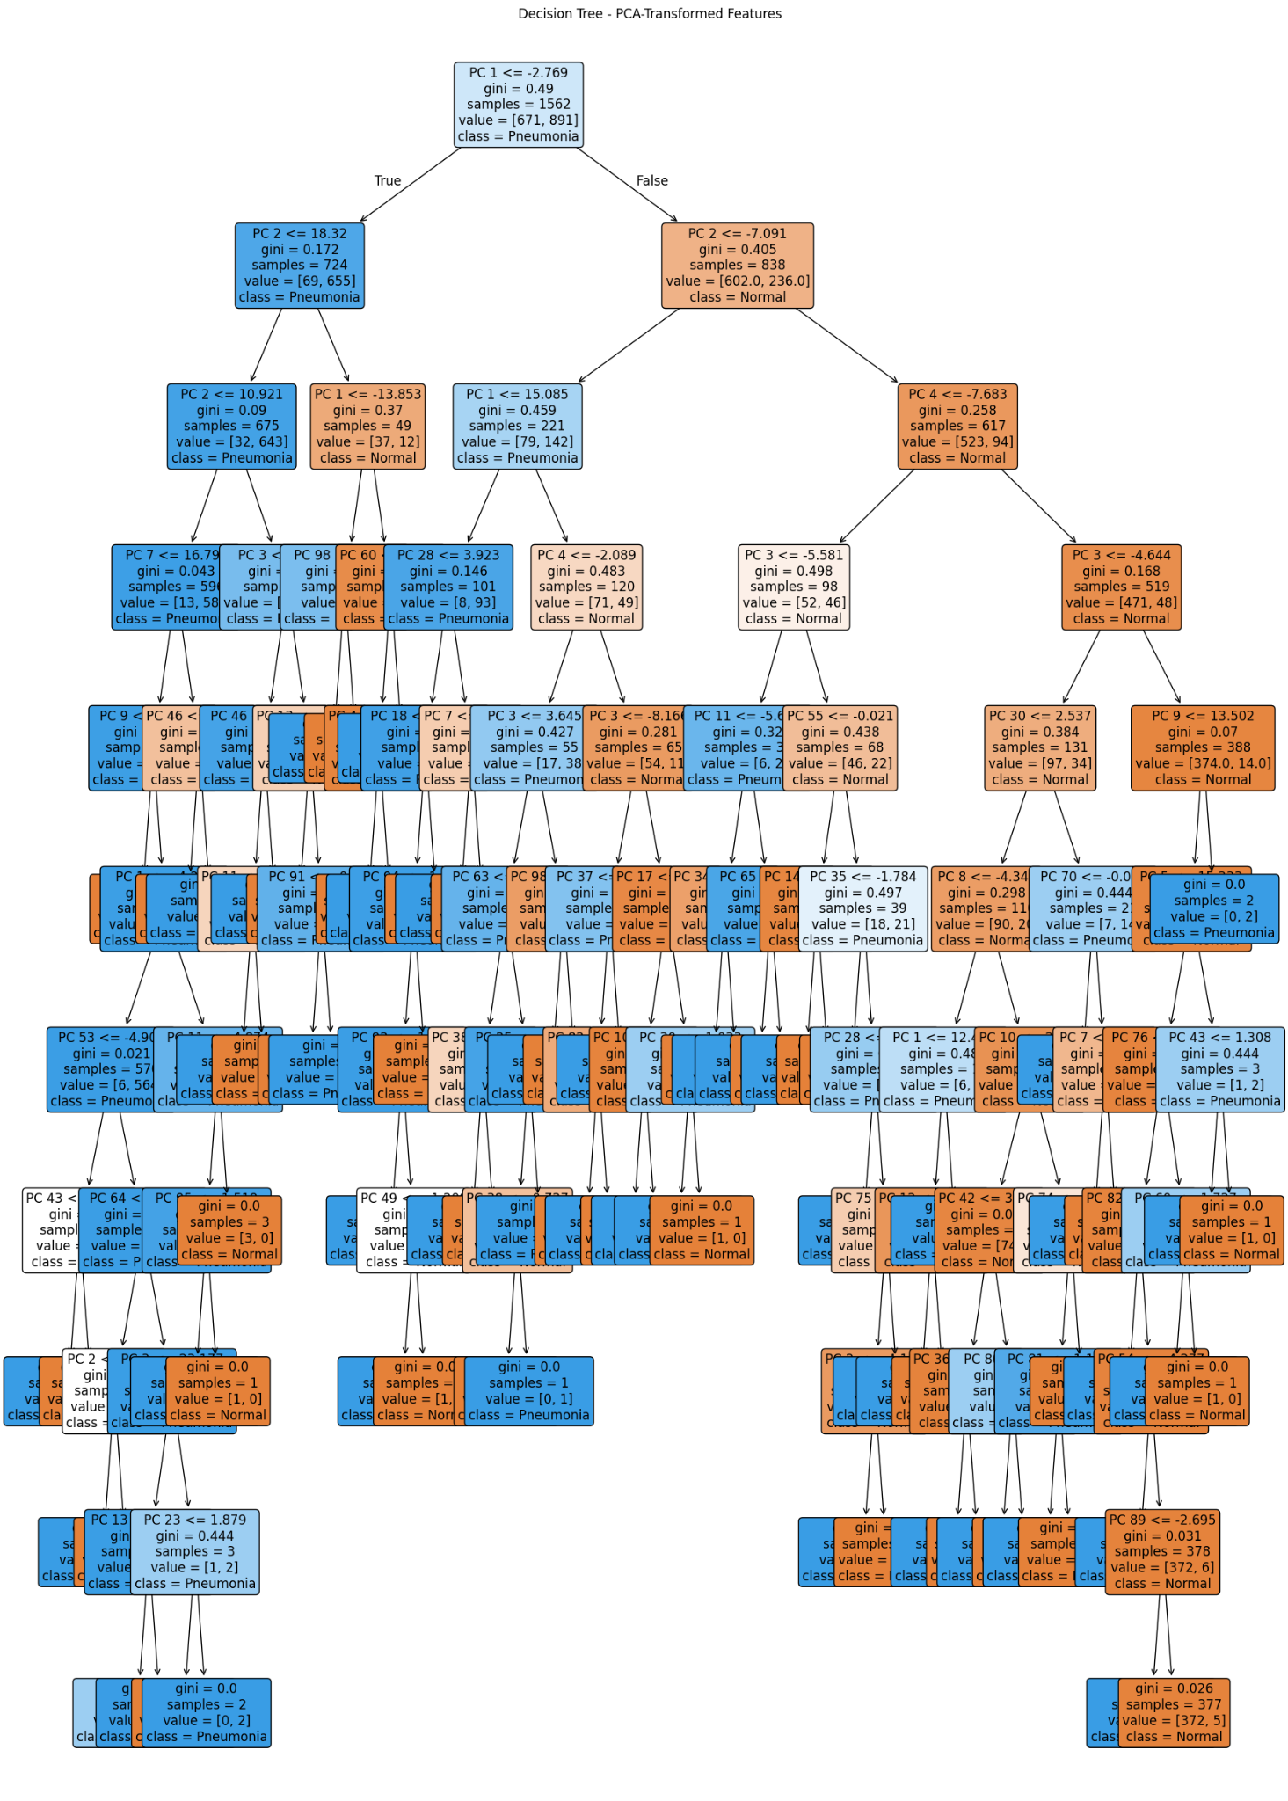
Interpretability (CNN+DT with Final)

Slide 13
Conclusion
CNN Only (ResNet50) had the highest accuracy (80.45%) BUT is a black-box model.
Best classification performance, but lacks transparency
CNN + Decision Tree (Multi-Layer) retained strong accuracy while improving interpretability
Small trade-off in accuracy for better decision explainability
CNN + Decision Tree (Final Layer Only) performed worse (74.52%)
Confirms that multi-layer features improve performance
PCA slightly reduced accuracy but improved decision tree creation efficiency
PCA led to reduced runtimes to build Decision Trees because of reduced feature dimensionality
Precision - Recall for CNN + Decision Tree (Multi-Layer):
Precision (0.79 for Pneumonia) → 79% of predicted pneumonia cases were correct.
Recall (0.92 for Pneumonia) → 92% of actual pneumonia cases were detected.

Slide 14
Future Work
Optimize PCA Components
Experiment with different numbers of features in PCA to find the best balance of interpretability vs. accuracy.
Test with other classifiers
Random forests, for example, could prove to provide better accuracy at the cost of lowered interpretability. Would have been interesting to test out.
Feature selection from CNN Layers
Currently using Conv2, Conv4, and FC (Final) Layer
Would testing Conv3, Conv5, or alternative layer combinations improve performance?
Generalization to other datasets
Would this work for MRI scans, CT scans, etc.?
Explainability Metrics
Apply SHAP or LIME to visualize the CNN and compare interpretability with Decision Tree

